Slide 1

DB ADMIN PORTAL
Role-Based Database Management System with AI Data Analyst
Developed By
Kashif , Anusha, Abhay, Akash, Abhinay, Raj , Rahul, Shristi and Vaishnavi
Python
Streamlit
SQLAlchemy ORM
MySQL
OpenRouter AI
Notes:
Good [morning/afternoon] everyone. I'm Mohammad Kashif Siddiqui, Team Lead, presenting the DB Admin Portal on behalf of our full team — a role-based database management system with an AI Data Analyst built on top of it. Over the next few minutes we'll walk through the problem, our solution, the architecture, and a live example of the AI in action.

Slide 2


Existing Problems
Why traditional database access falls short for most teams
Managing databases requires SQL knowledge.
No centralized user management.
Difficult permission control.
Data modifications are not tracked.
Business users cannot analyze data without SQL.
High chances of accidental data modification.
Coforge | DB Admin Portal
3
Notes:
Today, managing a database requires SQL knowledge, and there's no centralized way to manage users or control permissions. Data changes aren't tracked, business users can't analyze data without writing SQL, and it's very easy to accidentally modify or delete data. These six problems are exactly what our portal was built to solve.

Slide 3

Our Solution
A secure Database Administration Portal that provides:
Secure Login
Role-Based Access
Dynamic CRUD
User Management
Permission Management
Audit Logs
AI Data Analysis using Natural Language
Coforge | DB Admin Portal
4
Notes:
Our solution is a secure Database Administration Portal. It provides secure login, role-based access, dynamic CRUD operations, user management, permission management, full audit logs, and — the standout feature — AI-powered data analysis using natural language.

Slide 4

Objectives
What we set out to build
Build a secure database management portal
Implement Role-Based Access Control
Create generic CRUD operations
Dynamically reflect database schema
Track every database activity
Integrate AI for data analysis
Coforge | DB Admin Portal
5
Notes:
Our objectives were clear from the start: build a secure database management portal, implement role-based access control, create generic CRUD operations that work on any table, dynamically reflect the database schema, track every activity, and integrate AI for natural-language data analysis.

Slide 5

Technology Stack
Python 3.11
Streamlit
SQLAlchemy ORM
Backend
Web Interface
ORM Layer
MySQL
Pandas
bcrypt
Database
Data Processing
Password Encryption
Requests
OpenRouter
API Communication
AI Integration
Coforge | DB Admin Portal
6
Notes:
Here's the full technology stack: Python 3.11 for the backend, Streamlit for the web interface, SQLAlchemy as our ORM layer, and MySQL for storage. Pandas handles data processing, bcrypt encrypts passwords, Requests handles API communication, OpenRouter powers the AI integration, and OpenPyXL supports Excel export.

Slide 6
Project Team
Eight members,owning a distinct part of the system
Role | Team Member | Responsibilities
Team Lead and Management | Anusha & Kashif | Project Planning, Architecture, AI Integration, Code Integration, GitHub repository management, code review, testing, and team coordination.
Authentication Developer | Kashif & Akash | Developed the login system, session management, password hashing using bcrypt, and user authentication flow.
Database Developer | Anusha & Abhay | Designed the MySQL database schema, created ORM models, configured database connections, and implemented SQLAlchemy reflection.
CRUD Developer | Abhinay , Rahul and Raj | Implemented dynamic Create, Read, Update, and Delete operations with automatic form generation.
Permission and Audit Developer | Kashif & Akash | Developed RBAC, user management, permissions, and audit logging
UI Developer | Vaishnavi , Shristi and Kashif | Designed Streamlit pages, dashboard layout, navigation menu, and improved the user interface.
AI Integration | Kashif & Abhinay | Integrated AI chatbot, SQL generation, validation, and data analysis using OpenRouter API.
Coforge | DB Admin Portal
2
Notes:
Our team has eight members, each with clear ownership. I lead planning, architecture, AI integration, and final testing. The rest of the team owns authentication, database schema, CRUD modules, RBAC permissions, audit logging, the Streamlit UI, and testing and documentation — so every part of the system has a single accountable owner.

Slide 7
System Architecture
A layered flow from the user down to the AI-powered database layer
User
Streamlit UI
Authentication System
Role Based Access Control
CRUD + AI Modules
SQLAlchemy ORM
MySQL Database
OpenRouter API
Coforge | DB Admin Portal
7
Notes:
Here's the flow: the User interacts with the Streamlit UI, which passes through the Authentication System, then Role-Based Access Control. From there, requests hit the CRUD and AI modules, which go through SQLAlchemy ORM down to the MySQL database. For AI queries, the flow also connects out to the OpenRouter API for natural-language processing.

Slide 8
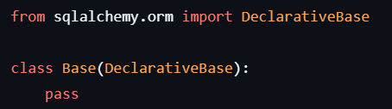
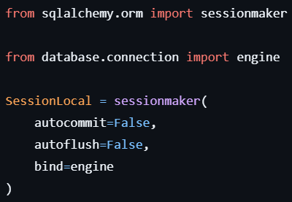
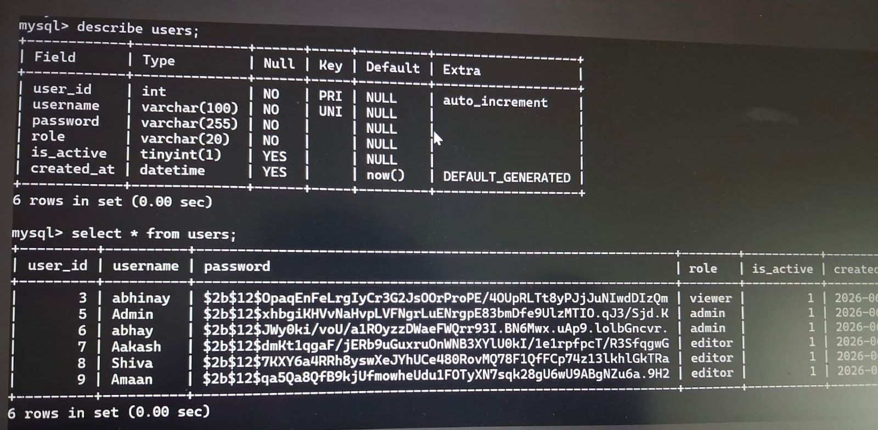
Database Design
Core tables powering the portal
base.py
Creates the common Declarative Base class
Parent class for all ORM models
Enables Object Relational Mapping (ORM)
session.py
Creates reusable SQLAlchemy sessions using SessionLocal
Manages database interaction efficiently
Connects application with the MySQL database engine
models.py
Defines Database Schema using ORM Models
User – Stores login credentials, roles and account status
TablePermission – Manages table-level CRUD permissions for each user
AuditLog – Records every important database activity with timestamps and status
Sample tables for business data
Coforge | DB Admin Portal
8
Notes:
Our schema centers on three system tables — users, table_permissions, and audit_logs — plus example business tables like customers and employees. Users and table_permissions are linked by username to control per-table access, and every change to a business table is written to audit_logs for full traceability.

Slide 9
Database Design
Core tables powering the portal
connection.py
Creates the SQLAlchemy Engine
Establishes secure connection with MySQL
Centralizes database configuration
reflection.py
Dynamically reflects existing database schema
Retrieves tables, columns and primary keys
Eliminates hardcoded database structures
create_admin.py
Creates the default Admin account
Initializes the application with administrator credentials
Ensures secure first-time access to the portal
Key Contributions:
✔ Configured MySQL database connectivity
✔ Implemented dynamic schema reflection
✔ Automated admin account initialization
✔ Enabled flexible and scalable database operations
Coforge | DB Admin Portal
8
Notes:
Our schema centers on three system tables — users, table_permissions, and audit_logs — plus example business tables like customers and employees. Users and table_permissions are linked by username to control per-table access, and every change to a business table is written to audit_logs for full traceability.

Slide 10

Authentication Module
Secure login built on hashed credentials and session state
Login
Password Hashing
Session Management
Role Verification
Coforge | DB Admin Portal
9
Notes:
Authentication covers login, bcrypt password hashing, Streamlit session management, and role verification on every request. [Show the login screenshot here and walk through the flow: user enters credentials, password is verified against the bcrypt hash, and a session is created with the user's role attached.]

Slide 11
Role Based Access Control
What each role can and cannot do
Feature | Admin | Editor | Viewer
View Data | ✔ | ✔ | ✔
Insert | ✔ | ✔ | ✖
Update | ✔ | ✔ | ✖
Delete | ✔ | ✖ | ✖
User Management | ✔ | ✖ | ✖
Permission Management | ✔ | ✖ | ✖
Audit Logs | ✔ | ✖ | ✖
AI Analysis | ✔ | ✔ | ✔
Coforge | DB Admin Portal
10
Notes:
Permissions are enforced role by role. Admins have full control — view, insert, update, delete, user management, permissions, and audit logs. Editors can view, insert, and update, but can't delete or manage users. Viewers are read-only. Notably, AI analysis is available to all three roles, since it's read-only under the hood.

Slide 12


Dynamic Database Reflection
No hardcoded tables — the portal adapts to your schema automatically
Implemented Functions
Benefits
Get All Tables
No hardcoded tables
Get Table Object
Generic CRUD
Get Primary Key
Supports new tables automatically
Dynamic Schema Detection
Coforge | DB Admin Portal
11
Notes:
A key engineering piece is dynamic database reflection. We built functions to get all tables, get a table object, get the primary key, and detect schema changes automatically. The benefit is that nothing is hardcoded — our CRUD is fully generic, so if a new table is added to the database, the portal supports it automatically.

Slide 13




CRUD Operations
Generic operations that work on any reflected table
Create
Read
Update
Delete
Dynamic Forms
Dynamic Data Viewer
Load Record
Delete by Primary Key
screenshot
screenshot
screenshot
screenshot
Coforge | DB Admin Portal
12
Notes:
All four CRUD operations are fully generic: Create uses dynamically generated forms based on the table's columns, Read uses a dynamic data viewer, Update loads the existing record into an editable form, and Delete removes a record by its primary key. [Insert screenshots of each screen here.]

Slide 14


User & Permission Management
What an Admin can do
Create Users
Table-Level Permissions
Delete Users
Permissions aren't just role-wide — an Admin can grant or revoke access to specific tables for a specific user, so an Editor can be scoped to only the tables they should touch.
Activate / Deactivate Users
Assign Permissions
Coforge | DB Admin Portal
13
Notes:
Admins have full control over the user lifecycle — they can create users, delete users, activate or deactivate accounts, and assign permissions. Importantly, permissions are table-level, not just role-wide, so an Admin can scope an Editor to only the specific tables they should be able to touch.

Slide 15
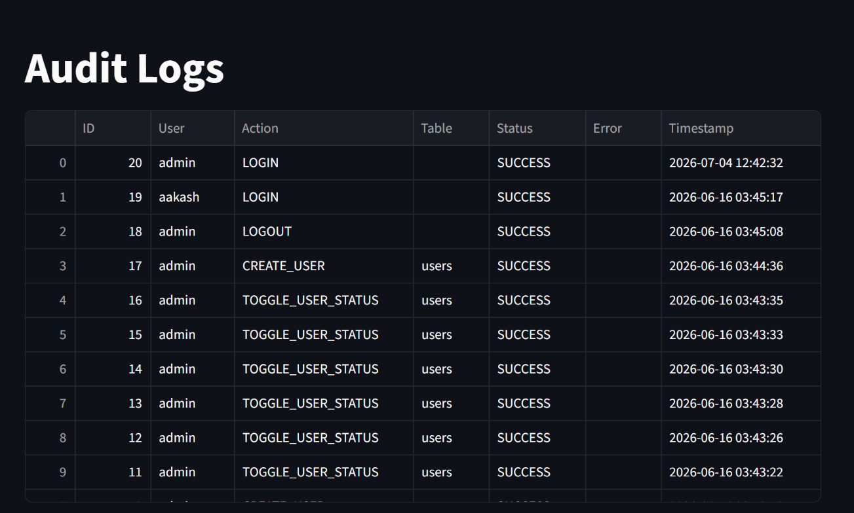


Audit Logging
A complete, tamper-evident trail of activity
Tracks
Login
Insert
Update
Audit Log Screenshot
Delete
(placeholder — insert product screenshot here)
Benefits
Security
Accountability
Monitoring
Coforge | DB Admin Portal
14
Notes:
Every login, insert, update, and delete is logged. This gives us three concrete benefits: security, since suspicious activity is visible; accountability, since every action is tied to a user; and monitoring, since admins can review activity trends over time. [Show the audit log screenshot here.]

Slide 16
AI Data Analyst
Ask questions in plain English — get validated SQL and real answers
User asks a question
Schema sent to AI
SQL Generated
SQL Validated
Query runs on Database
Results returned
AI Explanation
Coforge | DB Admin Portal
15
Notes:
This is our AI Data Analyst flow. A user asks a question in plain English — for example, 'Show top 5 highest salary employees.' We send the database schema to the AI, which generates SQL, which we then validate before it ever touches the database. Once validated, it runs against MySQL, the results come back, and the AI explains them in plain language.

Slide 17

AI Security
Every AI-generated query passes through a strict SQL validator
Only Allows
Blocks
SELECT
INSERT • UPDATE • DELETE • DROP • ALTER • TRUNCATE • CREATE
Read-only access ensures the AI can analyze data but never change it.
Coforge | DB Admin Portal
16
Notes:
Security is critical when AI is writing SQL. Our validator only allows SELECT statements — the AI can read and analyze data but can never modify it. It explicitly blocks INSERT, UPDATE, DELETE, DROP, ALTER, TRUNCATE, and CREATE, so even if the AI generated a destructive query, it would never reach the database.

Slide 18
Live Example
User Question
Output Table
“Show top 5 highest salary employees”
Name | Department | Salary
Employee A | Engineering | ₹ 1,85,000
Employee B | Sales | ₹ 1,72,000
Employee C | Engineering | ₹ 1,68,000
Employee D | Finance | ₹ 1,60,000
Employee E | Marketing | ₹ 1,55,000
Generated SQL
SELECT *
FROM employees
ORDER BY salary DESC
LIMIT 5;
AI Explanation
The query retrieves all employee records sorted by salary in descending order and returns only the top 5, directly answering the user's question.
Sample output shown for illustration — replace with a real screenshot for the actual demo.
Coforge | DB Admin Portal
17
Notes:
Here's a concrete example. The user asks, 'Show top 5 highest salary employees.' The AI generates a clean SELECT query ordering by salary descending with a limit of 5. After validation, it runs against the database, returns this table, and the AI explains in plain language what the result means.

Slide 19
Challenges & Solutions
Real engineering problems we hit — and how we solved them
Challenge | Solution
SQLAlchemy Reflection | Dynamic Reflection Functions
Dynamic CRUD | Generic CRUD Modules
TINYINT Boolean Handling | Checkbox Mapping
Session Management | Streamlit Session State
AI Integration | OpenRouter API
SQL Security | SQL Validator
SSL Issues | Certificate Configuration
Coforge | DB Admin Portal
18
Notes:
Every project has real engineering challenges. SQLAlchemy reflection needed dynamic reflection functions. Making CRUD generic needed dedicated generic modules. TINYINT boolean handling was solved with checkbox mapping. Session management uses Streamlit's session state. AI integration runs through OpenRouter, SQL security is enforced by our validator, and SSL issues were resolved through certificate configuration.

Slide 20

Future Enhancements
Where we're taking this next
Excel Export
CSV Export
Dashboard Analytics
Charts & Graphs
Bulk Upload
Backup & Restore
Multi-Database Support
Voice-based AI Queries
AI Recommendations
Cloud Deployment
Coforge | DB Admin Portal
19
Notes:
Looking ahead, our roadmap includes Excel and CSV export, dashboard analytics with charts and graphs, bulk upload, backup and restore, multi-database support, voice-based AI queries, AI-driven recommendations, and eventually full cloud deployment.

Slide 21
Conclusion & Demo
Project Summary
Live Demo Flow
Secure Authentication
1
Login
2
Dashboard
Role-Based Access Control
3
View Tables
4
Insert Record
5
Update Record
6
Delete Record
Dynamic Database Reflection
7
Manage Users
8
Assign Permissions
Generic CRUD Operations
9
View Audit Logs
10
AI Data Analyst
User & Permission Management
Audit Logging
AI-Powered Natural Language Data Analysis (In Progress)
Coforge | DB Admin Portal
20
Notes:
To summarize, we successfully built a secure, scalable Database Administration Portal with secure authentication, role-based access control, dynamic database reflection, generic CRUD operations, user and permission management, audit logging, and AI-powered natural language data analysis, currently in progress. Now let's move into the live demo — I'll walk through login, the dashboard, viewing and editing tables, managing users and permissions, viewing audit logs, and finally the AI Data Analyst.

Slide 22

Thank You
Questions & Answers
Notes:
Thank you for your time. That concludes our presentation on the DB Admin Portal — we're happy to take any questions now.

